Slide 1

ARCHITECTURE REVIEW BOARD
10/February/2025
GL_SAP_Continuous_Auditing
Project Type: Enhance
Org. Unit(s): CB

Slide 2
AGENDA
Background
Project objective
Architecture diagrams
Security Diagram / Port
Telecomm diagram
Footprint
Azure Cloud Requirements
Capacity / Decommissioning plan
Risks identification & mitigation plan

Slide 3
Background

Slide 4
Project Objective

Slide 5
Consider to have the following Information in diagrams separately (if apply and according to the proposal to be presented):
Security Diagram: Firewall, IPS, WAF and load balancer, data encryption information, data flow encryption. (One per each environment Dev, Qas, Prod)
Telecom Diagram: IP’s, ports, Datacenters diagram, indicate_source_destination_communication_flow.
Cloud/Infrastructure: Provide specific RTO – Recovery Time Objective and RPO – Recovery Point Objective, Infrastructure requirements, HA requirements, OS, private and/or public connectivity requirements. (One per each environment Dev, Qas, Prod)
Digital workplace: AD integration or user Management process, integration with serviceNow.
Field Services: What kind of onsite support is required.
Governance: SLA’s Information, NDA Information, GB organizations involved in contract.
Enterprise applications: Integration methods, development languages, Technology components requirements.
IAM: Describe planned integration with Identity Access Management Solution.
Consider to have the following Information in diagrams separately (if apply and according to the proposal to be presented):
Security Diagram: Firewall, IPS, WAF and load balancer, data encryption information, data flow encryption. (One per each environment Dev, Qas, Prod)
Telecom Diagram: IP’s, ports, Datacenters diagram, indicate_source_destination_communication_flow.
Cloud/Infrastructure: Provide specific RTO – Recovery Time Objective and RPO – Recovery Point Objective, Infrastructure requirements, HA requirements, OS, private and/or public connectivity requirements. (One per each environment Dev, Qas, Prod)
Digital workplace: AD integration or user Management process, integration with serviceNow.
Field Services: What kind of onsite support is required.
Governance: SLA’s Information, NDA Information, GB organizations involved in contract.
Enterprise applications: Integration methods, development languages, Technology components requirements.
IAM: Describe planned integration with Identity Access Management Solution.

Slide 6
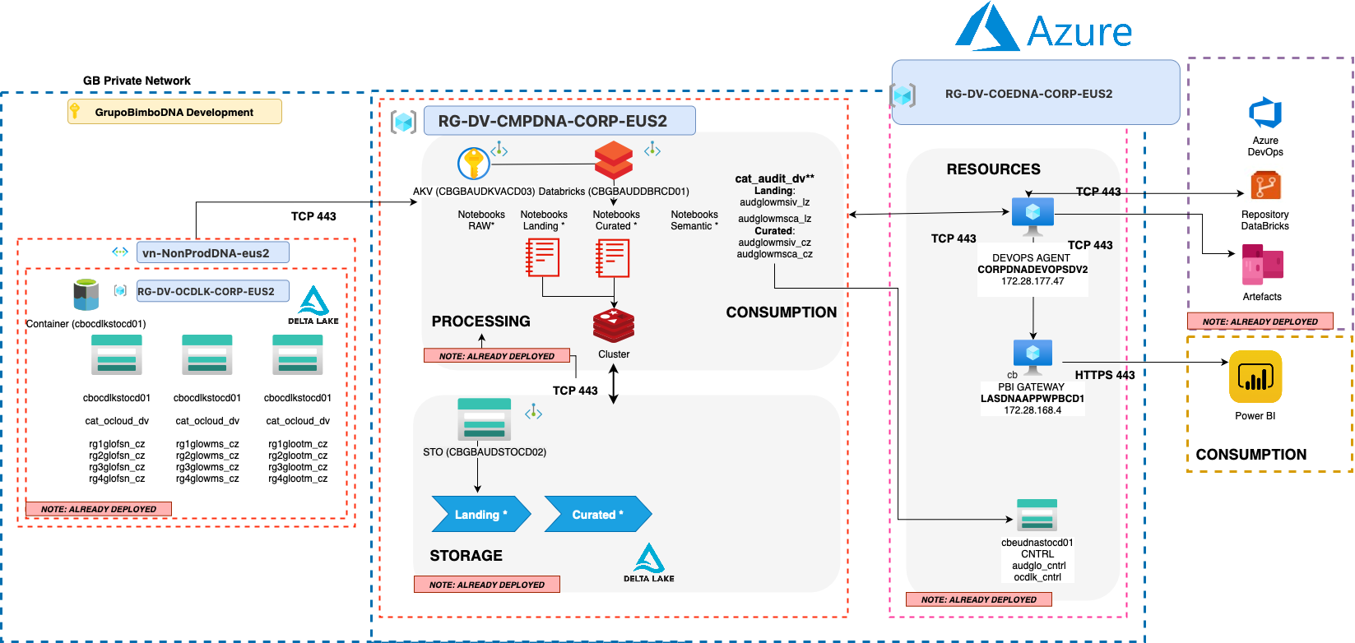
Architecture diagram (As Is)
DEV

Slide 7
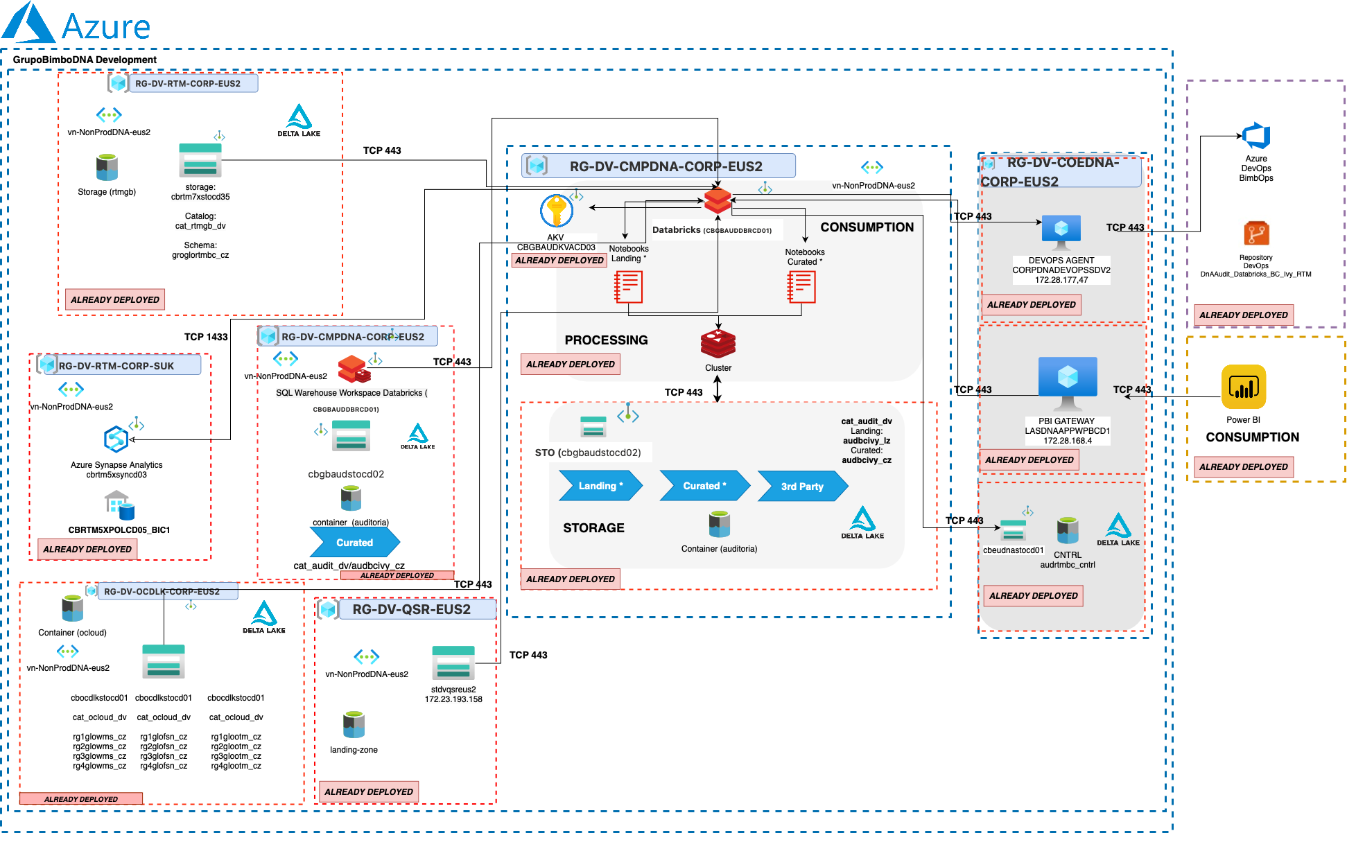
Architecture diagram (To be)
DEV

Slide 8
Ports
DEV
Subnet (Public / Private) | Direction (Ingress / Egress) | Source or Destination System / ID | Protocol | Source Port | Destination Port
Private | Ingress | Databricks – CBGBAUDDBRCD01 -> Storage Account - cbrtm7xstocd35 | TCP | 443 | 443
Private | Ingress | Databricks – CBGBAUDDBRCD01 -> Storage Account - cbocdlkstocd01 | TCP | 443 | 443
Private | Ingress/Egress | Databricks – CBGBAUDDBRCD01 -> Storage Account - cbgbaudstocd02 | TCP | 443 | 443
Private | Ingress | Databricks – CBGBAUDDBRCD01 -> PBI Gateway – LASDNAAPPWPBCD1 | TCP | 443 | 443
Private | Ingress | Databricks – CBGBAUDDBRCD01 -> DEVOPS Agent CORPDNADEVOPSSDV2 | TCP | 443 | 443
Private | Ingress | Databricks – CBGBAUDDBRCD01 -> Storage Account – cbeudnastocd01 | TCP | 443 | 443
Private | Egress | SQL Warehouse Workspace Databricks -> PBI GATEWAY (LASDNAAPPWPBCD1) | TCP | 443 | 443

Slide 9
Ports
DEV
Subnet (Public / Private) | Direction (Ingress / Egress) | Source or Destination System / ID | Protocol | Source Port | Destination Port

Slide 10
IP Whitelist
DEV
Rule Name | IP
cbrtm7xstocd35 - GB VPN Triara | 192.100.176.95
cbocdlkstocd01 - GB VPN Santa Fe | 201.174.135.26
cbocdlkstocd01 - GB VPN Triara | 192.100.176.95
cbgbaudstocd02 - GB VPN Santa Fe | 201.174.135.26
cbgbaudstocd02 - GB VPN Triara | 192.100.176.95

Slide 11
Integrated VNets
DEV
Storage | vnet
Cbrtm7xstocd35, cbgbaudstocd02, cbocdlkstocd01 | /subscriptions/23a8c420-c354-43f9-91f5-59d08c6b3dff/resourceGroups/prod-eastus2-snp-1-compute-2/providers/Microsoft.Network/virtualNetworks/kaas-vnet/subnets/worker-subnet,
Cbrtm7xstocd35, cbgbaudstocd02, cbocdlkstocd01 | /subscriptions/31ef391b-7908-48ec-8c74-e432113b607b/resourceGroups/prod-eastus2-snp-1-compute-3/providers/Microsoft.Network/virtualNetworks/kaas-vnet/subnets/worker-subnet,
Cbrtm7xstocd35, cbgbaudstocd02, cbocdlkstocd01 | /subscriptions/56beece1-dbc8-40ca-8520-e1d514fb2ccc/resourceGroups/prod-eastus2-snp-1-compute-8/providers/Microsoft.Network/virtualNetworks/kaas-vnet/subnets/worker-subnet,
Cbrtm7xstocd35, cbgbaudstocd02, cbocdlkstocd01 | /subscriptions/653c13e3-a85b-449b-9d14-e3e9c4b0d391/resourceGroups/prod-eastus2-snp-1-compute-6/providers/Microsoft.Network/virtualNetworks/kaas-vnet/subnets/worker-subnet,
Cbrtm7xstocd35, cbgbaudstocd02, cbocdlkstocd01 | /subscriptions/6c0d042c-6733-4420-a3cc-4175d0439b29/resourceGroups/prod-eastus2-snp-1-compute-4/providers/Microsoft.Network/virtualNetworks/kaas-vnet/subnets/worker-subnet,

Slide 12
Integrated VNets
DEV
Storage | vnet
Cbrtm7xstocd35, cbgbaudstocd02, cbocdlkstocd01 | /subscriptions/8453a5d5-9e9e-40c7-87a4-0ab4cc197f48/resourceGroups/prod-azure-eastus2c2-nephos6/providers/Microsoft.Network/virtualNetworks/kaas-vnet/subnets/worker-subnet,
Cbrtm7xstocd35, cbgbaudstocd02, cbocdlkstocd01 | /subscriptions/8453a5d5-9e9e-40c7-87a4-0ab4cc197f48/resourceGroups/prod-azure-eastus2c2-nephos7/providers/Microsoft.Network/virtualNetworks/kaas-vnet/subnets/worker-subnet,
Cbrtm7xstocd35, cbgbaudstocd02, cbocdlkstocd01 | /subscriptions/8453a5d5-9e9e-40c7-87a4-0ab4cc197f48/resourceGroups/prod-azure-eastus2c3-nephos3/providers/Microsoft.Network/virtualNetworks/kaas-vnet/subnets/worker-subnet,
Cbrtm7xstocd35, cbgbaudstocd02, cbocdlkstocd01 | /subscriptions/8453a5d5-9e9e-40c7-87a4-0ab4cc197f48/resourceGroups/prod-azure-eastus2c3-nephos4/providers/Microsoft.Network/virtualNetworks/kaas-vnet/subnets/worker-subnet,
Cbrtm7xstocd35, cbgbaudstocd02, cbocdlkstocd01 | /subscriptions/8453a5d5-9e9e-40c7-87a4-0ab4cc197f48/resourceGroups/prod-eastus2-snp-1-compute-1/providers/Microsoft.Network/virtualNetworks/kaas-vnet/subnets/worker-subnet,

Slide 13
Integrated VNets
DEV
Storage | vnet
Cbrtm7xstocd35, cbgbaudstocd02, cbocdlkstocd01 | /subscriptions/9d5fffc7-7640-44a1-ba2b-f77ada7731d4/resourceGroups/prod-eastus2-snp-1-compute-5/providers/Microsoft.Network/virtualNetworks/kaas-vnet/subnets/worker-subnet,
Cbrtm7xstocd35, cbgbaudstocd02, cbocdlkstocd01 | /subscriptions/b4f59749-ad17-4573-95ef-cc4c63a45bdf/resourceGroups/prod-eastus2-snp-1-compute-10/providers/Microsoft.Network/virtualNetworks/kaas-vnet/subnets/worker-subnet,
Cbrtm7xstocd35, cbgbaudstocd02, cbocdlkstocd01 | /subscriptions/b96a1dc5-559f-4249-a30c-5b5a98023c45/resourceGroups/prod-eastus2-snp-1-compute-7/providers/Microsoft.Network/virtualNetworks/kaas-vnet/subnets/worker-subnet,
Cbrtm7xstocd35, cbgbaudstocd02, cbocdlkstocd01 | /subscriptions/d31d7397-093d-4cc4-abd6-28b426c0c882/resourceGroups/prod-eastus2-snp-1-compute-9/providers/Microsoft.Network/virtualNetworks/kaas-vnet/subnets/worker-subnet

Slide 14
WS Databricks Considerations
All Porpuse Serverless Cluster (Notebook)
Enviornment | Type | Worker Type | Driver Type | Min Workers | Max Workers | Enable Autoscaling | Runtime
Dev | Serverless | NA | NA | NA | NA | NA | NA
Job Compute Cluster (Workflow)
Enviornment | Type | Worker Type | Driver Type | Workers | Enable Autoscaling | Runtime
Dev | Serverless | NA | NA | NA | NA | NA

Slide 15
WS Databricks Considerations
SQL Warehouse Cluster
Enviornment | Type | Worker Type | Driver Type | Workers | Enable Autoscaling | Runtime
Dev | Serverless | NA | NA | NA | NA | NA

Slide 16
Paths
DEV
ADLS2 | Container | Folder | Catalog UC | Source/Target
cbocdlkstocd01 | ocloud | fusion | cat_ocloud_dv | Source
cbocdlkstocd01 | ocloud | hcm | cat_ocloud_dv | Source
cbocdlkstocd01 | ocloud | otm | cat_ocloud_dv | Source
cbocdlkstocd01 | ocloud | wms | cat_ocloud_dv | Source
Data Zone | Folder Path | Catalog UC | Schema UC | Full Path | Source/Target
Curated | ocloud/r1/fusion/curated | cat_ocloud_dv | rg1glofsn_cz | abfss://ocloud@cbocdlkstocd01.dfs.core.windows.net/r1/fusion/curated | Source
Curated | ocloud/r1/hcm/curated | cat_ocloud_dv | rg1glohcm_cz | abfss://ocloud@cbocdlkstocd01.dfs.core.windows.net/r1/hcm/curated | Source
Curated | ocloud/r1/otm/curated | cat_ocloud_dv | rg1glootm_cz | abfss://ocloud@cbocdlkstocd01.dfs.core.windows.net/r1/otm/curated | Source
Curated | ocloud/r1/wms/curated | cat_ocloud_dv | rg1glowms_cz | abfss://ocloud@cbocdlkstocd01.dfs.core.windows.net/r1/wms/curated | Source

Slide 17
Paths
DEV
ADLS2 | Container | Folder | Catalog UC | Source/Target
cbocdlkstocd01 | ocloud | fusion | cat_ocloud_dv | Source
cbocdlkstocd01 | ocloud | hcm | cat_ocloud_dv | Source
cbocdlkstocd01 | ocloud | otm | cat_ocloud_dv | Source
cbocdlkstocd01 | ocloud | wms | cat_ocloud_dv | Source
Data Zone | Folder Path | Catalog UC | Schema UC | Full Path | Source/Target
Curated | ocloud/r2/fusion/curated | cat_ocloud_dv | rg2glofsn_cz | abfss://ocloud@cbocdlkstocd01.dfs.core.windows.net/r2/fusion/curated | Source
Curated | ocloud/r2/hcm/curated | cat_ocloud_dv | rg2glohcm_cz | abfss://ocloud@cbocdlkstocd01.dfs.core.windows.net/r2/hcm/curated | Source
Curated | ocloud/r2/otm/curated | cat_ocloud_dv | rg2glootm_cz | abfss://ocloud@cbocdlkstocd01.dfs.core.windows.net/r2/otm/curated | Source
Curated | ocloud/r2/wms/curated | cat_ocloud_dv | rg2glowms_cz | abfss://ocloud@cbocdlkstocd01.dfs.core.windows.net/r2/wms/curated | Source

Slide 18
Paths
DEV
ADLS2 | Container | Folder | Catalog UC | Source/Target
cbocdlkstocd01 | ocloud | fusion | cat_ocloud_dv | Source
cbocdlkstocd01 | ocloud | hcm | cat_ocloud_dv | Source
cbocdlkstocd01 | ocloud | otm | cat_ocloud_dv | Source
cbocdlkstocd01 | ocloud | wms | cat_ocloud_dv | Source
Data Zone | Folder Path | Catalog UC | Schema UC | Full Path | Source/Target
Curated | ocloud/r3/fusion/curated | cat_ocloud_dv | rg3glofsn_cz | abfss://ocloud@cbocdlkstocd01.dfs.core.windows.net/r3/fusion/curated | Source
Curated | ocloud/r3/hcm/curated | cat_ocloud_dv | rg3glohcm_cz | abfss://ocloud@cbocdlkstocd01.dfs.core.windows.net/r3/hcm/curated | Source
Curated | ocloud/r3/otm/curated | cat_ocloud_dv | rg3glootm_cz | abfss://ocloud@cbocdlkstocd01.dfs.core.windows.net/r3/otm/curated | Source
Curated | ocloud/r3/wms/curated | cat_ocloud_dv | rg3glowms_cz | abfss://ocloud@cbocdlkstocd01.dfs.core.windows.net/r3/wms/curated | Source

Slide 19
Paths
DEV
ADLS2 | Container | Folder | Catalog UC | Source/Target
cbocdlkstocd01 | ocloud | fusion | cat_ocloud_dv | Source
cbocdlkstocd01 | ocloud | hcm | cat_ocloud_dv | Source
cbocdlkstocd01 | ocloud | otm | cat_ocloud_dv | Source
cbocdlkstocd01 | ocloud | wms | cat_ocloud_dv | Source
Data Zone | Folder Path | Catalog UC | Schema UC | Full Path | Source/Target
Curated | ocloud/r4/fusion/curated | cat_ocloud_dv | rg4glofsn_cz | abfss://ocloud@cbocdlkstocd01.dfs.core.windows.net/r4/fusion/curated | Source
Curated | ocloud/r4/hcm/curated | cat_ocloud_dv | rg4glohcm_cz | abfss://ocloud@cbocdlkstocd01.dfs.core.windows.net/r4/hcm/curated | Source
Curated | ocloud/r4/otm/curated | cat_ocloud_dv | rg4glootm_cz | abfss://ocloud@cbocdlkstocd01.dfs.core.windows.net/r4/otm/curated | Source
Curated | ocloud/r4/wms/curated | cat_ocloud_dv | rg4glowms_cz | abfss://ocloud@cbocdlkstocd01.dfs.core.windows.net/r4/wms/curated | Source

Slide 20
Paths
DEV
ADLS2 | Container | Folder | Catalog UC | Source/Target
cbocdlkstocd01 | ocloud | fusion | cat_ocloud_dv | Source
cbocdlkstocd01 | ocloud | hcm | cat_ocloud_dv | Source
cbeudnastocd01 | cntr | audit | cat_cntrlproc_dv | Target
Data Zone | Folder Path | Catalog UC | Schema UC | Full Path | Source/Target
Curated | ocloud/r5/fusion/landing | cat_ocloud_dv | rg5glofsn_cz | abfss://ocloud@cbocdlkstocd01.dfs.core.windows.net/r5/fusion/curated | Source
Landing | ocloud/r5/fusion/landing | cat_ocloud_dv | rg5glofsn_lz | abfss://ocloud@cbocdlkstocd01.dfs.core.windows.net/r5/fusion/landing | Source
Control | cntrl/audit | cat_cntrlproc_dv | audivybc_cntrl | abfss://cntrl@cbeudnastocd01.dfs.core.windows.net/rpfin | Target

Slide 21
Paths
DEV
ADLS2 | Container | Folder | Catalog UC | Source/Target
cbrtm7xstocd35 | rtmgb |  | cat_rtmgb_dv | Source
cbgbaudstocd02 | auditoria | aud_ivy_bc | cat_audit_dv | Target
Data Zone | Folder Path | Catalog UC | Schema UC | Full Path | Source/Target
Curated |  | cat_rtmgb_dv | groglortmbc_cz |  | Source
Curated | ivy_rtm_bc/curated | cat_audit_dv | ivy_rtm_bc | abfss://auditoria@cbgbaudstocd02.dfs.core.windows.net/ivy_rtm_bc/curated | Target

Slide 22
Volume – Non Applicable
DEV
Volume | Folder Path | Catalog UC | Schema UC | Full Path

Slide 23











Architecture Diagram for Databricks Serverless
GB Private Network
Databricks Network
GrupoBimboDNA Development
Databricks Environment
RG-DV-CMPDNA-CORP-EUS2
Resource Group
vn-NonProdDNA-eus2
Vnet Databricks per region
Private Link
Serverless Compute
cbgbaudstocd02

Slide 24
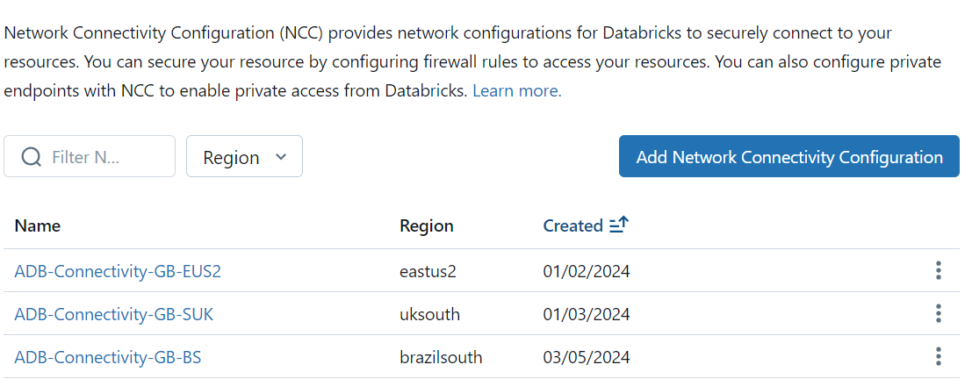
Databricks Serverless capabilities
One requirement to use the Databricks Serverless is enable a private link with Databricks Network, this private link works, one per Azure region thru Microsoft Backbone, but from Databricks standpoint there’s no chance to segment Vnet per environment. This is important because we’re connecting to one single environment of Databricks to use the Serverless capabilities.

Slide 25
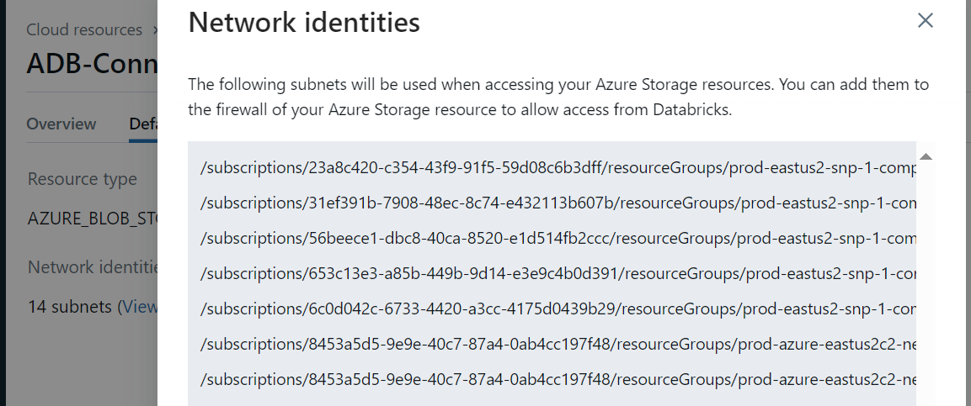
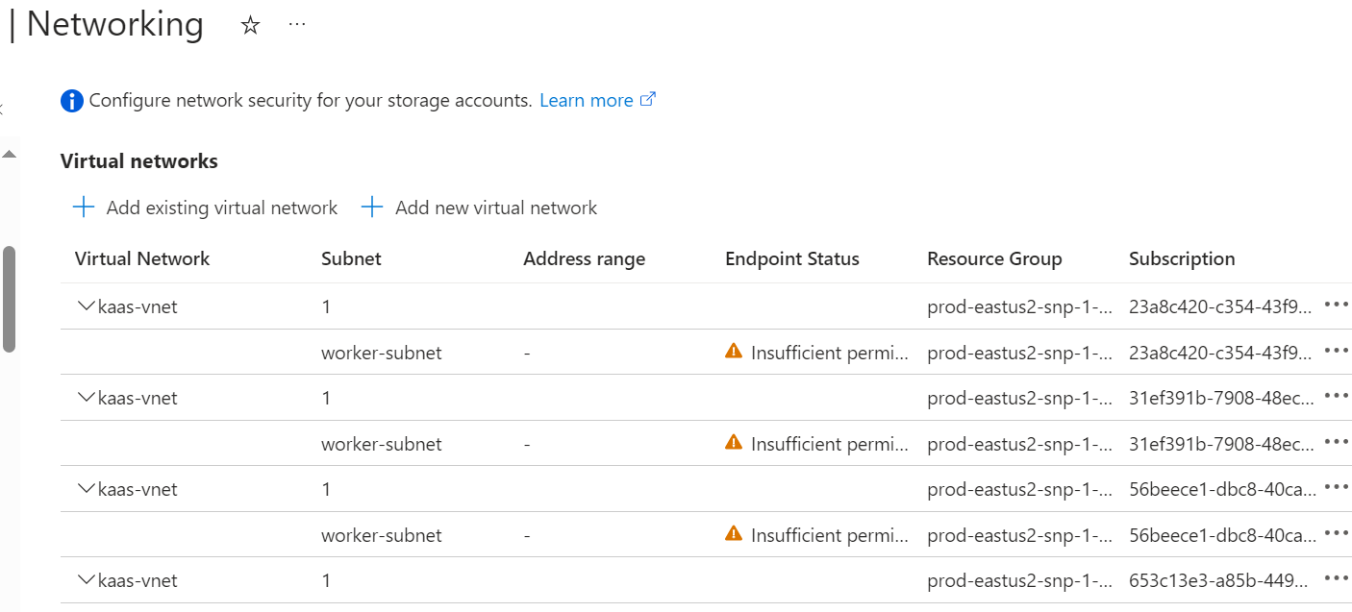
Databricks Serverless capabilities
Inside of each private link per region, exists all vnet’s (per region) we need to add into the firewall storage account where Databricks store the data:

Slide 26
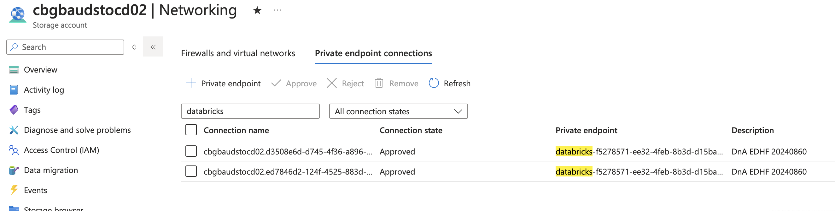
Databricks Serverless capabilities
Additional is necessary approve two private endpoints (Dfs & Blob) in storage account used to store the data.

Slide 27
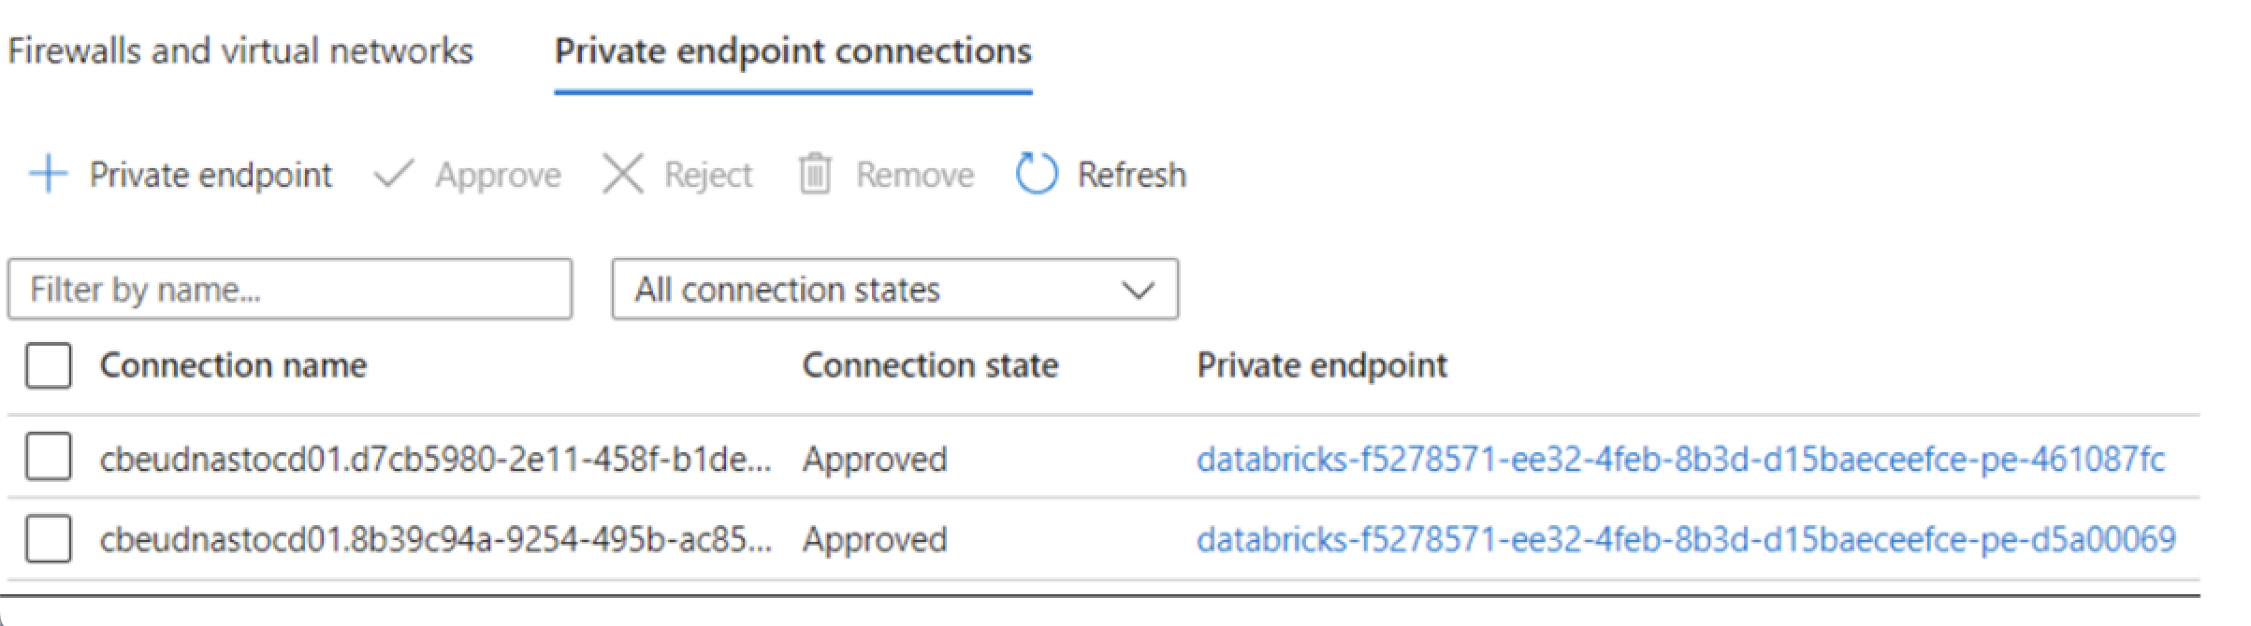
Databricks Serverless capabilities
Additional is necessary approve two private endpoints (Dfs & Blob) in storage account used to store the data.

Slide 28
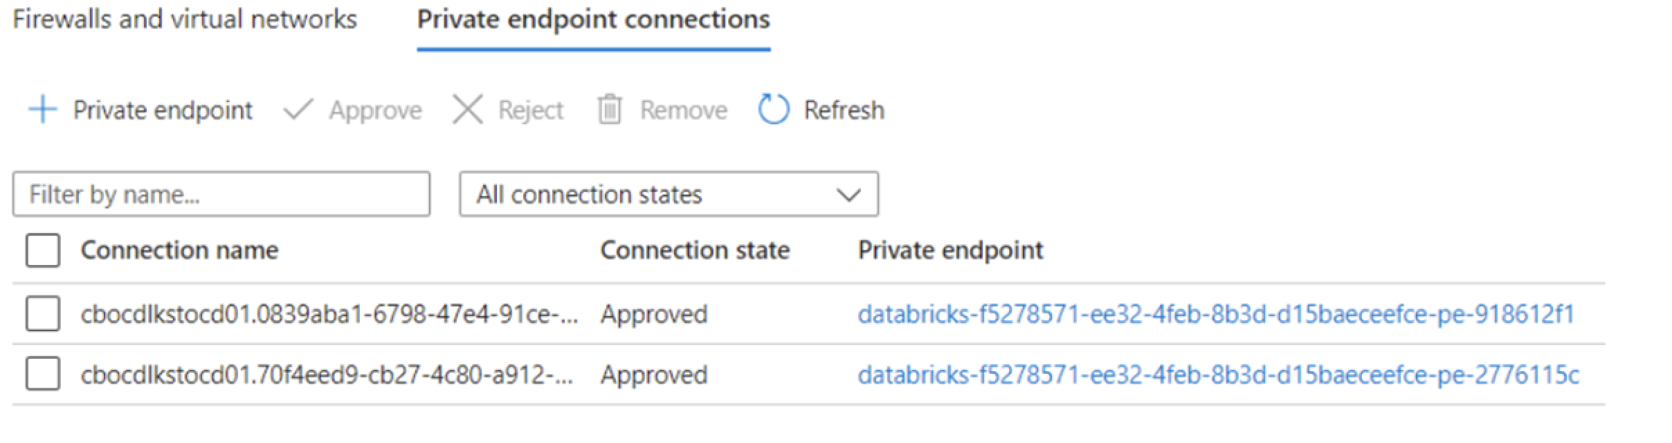
Databricks Serverless capabilities
Additional is necessary approve two private endpoints (Dfs & Blob) in storage account used to store the data.

Slide 29
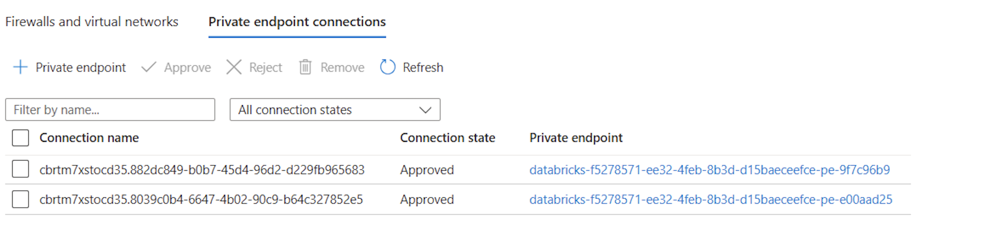
Databricks Serverless capabilities
Additional is necessary approve two private endpoints (Dfs & Blob) in storage account used to store the data.

Slide 30
Files Policy – Not applicable
DEV/QAS/PROD
Example:
User
Description
Auth
Quantity
Size
Format
Container/Path
Retention Policy
Self Debugging Routine

Slide 31
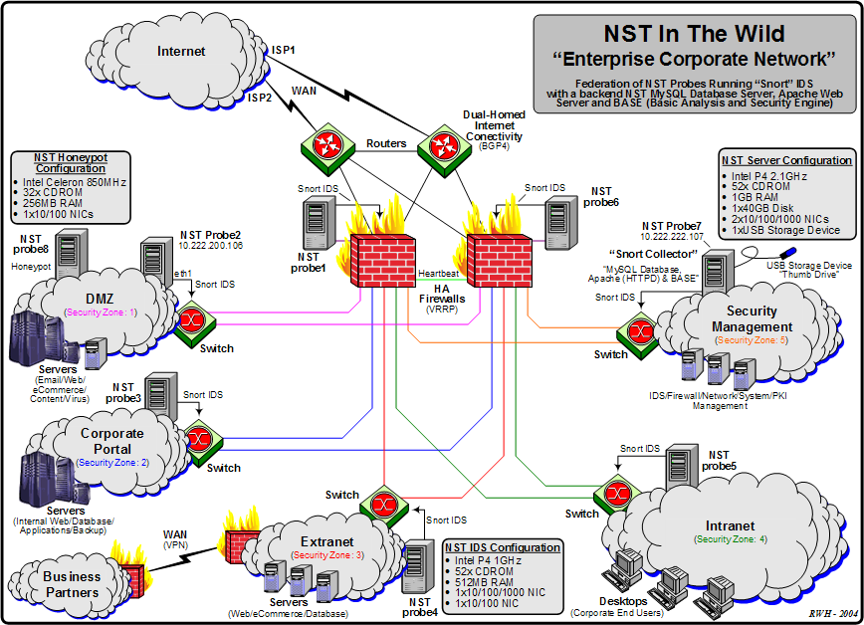
Security Diagram (example) - Not applicable
Example:
DEV/QAS/PROD

Slide 32
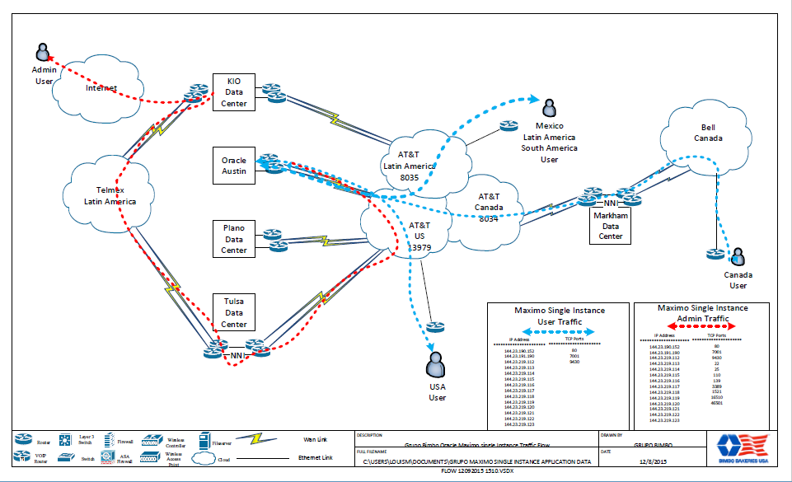
Telecomm Diagram (example) - Not applicable
<Datacenters diagram /> <indicate_source_destination_communication_flow />
Example:
<Datacenters diagram /> <indicate_source_destination_communication_flow />
Example:
DEV/QAS/PROD

Slide 33
Footprint (example) - Not applicable
<Provide a sense of sizing of your project />
Example:
HCM R12
On Premise
Oracle eBusiness Suite R12.1.3
Cloud solution – Single instance
Oracle Demantra / ASCP R12.2.4
Cloud Solution
Finance
Supply Chain
Planning
Personnel (HR)
General Ledger
(GL)
Fixed
Assets
(FA)
Work in Process
(WIP)
Bills of Materials
(BOM)
Demantra
Advanced Supply Chain Planning (ASCP)
Self Service
Account Receivables
(AR)
Account Payables
(AP)
Quality
(QA)
Engineering
(ENG)
Advance Benefits (OAB)
E-Business Tax
(EB-Tax)
Cost Mngmnt
(CST)
Inventory
(INV)
Order Mngmnt
(ONT)
Oracle Transportation
Cloud Solution R 6.2.9
DEV/QAS/PROD
Transport
Mngmnt
(OTM)
Trade Mngmnt
(TMA)
Project Costing
(PA)
Purchasing
(PO)
Sourcing
(ICS)
User Productivity Kit
Cloud Solution
UPK
Advance Pricing
eCommerce
Gateway (ECG)
iProcure-ment
(ICX)
i-Supplier Portal
(ISP)
Various WHB Legacy Applications
Other GB On Premise Solutions
Other GB Cloud Solutions
ADP
(Payroll)
Other legacies
Maximo
(Maintenance
Plant)
CPTe
(TBD)
Kronos
(Time & Attendance)
Concur
(T&E)
IBM/Sterling
(EDI)

Slide 34
Endpoints (Only if applies) - Not applicable
Example:
DEV/QAS/PROD
Env | Link | Use | IP Address

Slide 35
Azure Cloud Requirements (Only if applies) - Not applicable
Example:
DEV/QAS/PROD
Component | Quantity | Load Balancer (HA) and Public IP | Azure System Configuration | Comments

Slide 36
Decomissio Plan – Not applicable
Specify the planned decommissioning plan:
Server name | Function | Virtual or physical | Location | Estimated decommission date

Slide 37
Capacity Plan -Not applicable
Specify the planned transaction volumes:
Component | Function | Transactions sizing
Describe the planned roll-out plan:
Not applicable

Slide 38
Risks identification & mitigation plan
Risk | Type | Timeframe | Probability | Impact | Risk Exposure
 |  | Short Term—Likely to materialize in the next 6 months Medium Term—Likely to materialize in 6 to 12 months Long Term—Likely to materialize in longer than 12 months | 1—Less than 10% 2—10% to 50% 3—Higher than 50% | 1—Minor, can be endured with workarounds for months 2—Serious, workable with workarounds, Hundreds of thousands of dollars in damages if materialized 3—Fatal, unworkable, Millions of dollars in damages if materialized | [Probability * Impact] | Action Plan
Sensitive Audit data could be exposed during the transfer process
Compatibility issues between Workiva and Azure Databricks may arise
Changing project requirements or scope
Lack of key resources or required skillset

Slide 39
THANKS!

